Slide 1

EMBEDDED LINUX PROJECT
Smart Lighting System
SL.NO | NAME | USN
1. | Jamuna Pulapatli | 02FE22BEC032
2. | Priyanka Budihal | 02FE22BEC054
3. | Rutuja | 02FE22BEC072
4. | Saniya | 02FE22BEC081
5. | Santoshi Uppin | 02FE22BEC0
Under the Guidance of
PROF. ANITHA SHIROL

Slide 2
PROBLEM STATMENT
Traditional lighting consumes power even when natural daylight is available. Lack of automation results in energy wastage. There is a need for an intelligent system that automatically controls lighting based on ambient light levels to improve energy efficiency.

Slide 3
Literature Survey
SL.NO | Paper Title | Methodology | Objectives | Limitations
1. | Automated Street Lighting System Using IoT | ESP32 + LDR + Relay hardware Arduino IDE coding Blynk app for remote monitoring Auto ON/OFF based on light intensity | Save energy & cost Automate switching Remote monitoring/control Increase lamp life Support eco-friendly use | Needs Wi-Fi Small-scale demo Sensor affected by weather/dust Security risks in IoT
2. | Advanced and Automatic Smart Street Light Using Dimming Control and Motion Sensor | LDR + Motion Sensor Microcontroller (Arduino/Raspberry Pi) Relay drivers for ON/OFF & dimming PWM adjusts brightness (20–100%) by traffic | Save energy Reduce maintenance cost Improve safety & visibility Cut light pollution Enable smart city use | Needs internet/communication Higher setup cost Sensor errors in bad weather Scalability issues IoT security risks

Slide 4
SL.NO | Paper Title | Methodology | Objectives | Limitations
3. | Design and Implementation of a Real-Time Street Light Dimming System Based on a Hybrid Control Architecture | Hybrid control: local (sensors + microcontroller) + central (cloud). RF motion + LDR sensors. NBIoT (UDP) for communication. Tested with 90W LED lamps (dim/full/off). | Save energy via adaptive dimming. Real-time response to traffic & weather. Detect & locate lamp faults. Enable continuous monitoring. | Dependent on NBIoT network. Higher setup cost. Sensor errors in bad weather. Cybersecurity risks. Tested only on small scale.
4. | Dimmer Based Smart Street Lighting using Raspberry Pi and IoT | Raspberry Pi → Master controller Arduino → Slave nodes at poles LDR & PIR sensors → detect light & motion Dimmer circuit → adjusts brightness via PWM RF transceiver → master–slave communication Data uploaded to cloud for monitoring | Automate street light ON/OFF Save energy with dimming Enable fault detection & monitoring Reduce manpower and electricity loss | Higher setup cost than manual systems Weather/sensor dependency Needs internet/cloud connectivity More hardware = higher complexity

Slide 5
Board selection for the Project
We have selected Raspberry pi
Because,
1. Embedded Linux Platform
Raspberry Pi runs Raspbian (or other Linux-based OS), which allows you to run Python scripts and manage GPIO pins easily.
You can install packages and libraries to control hardware efficiently.
2. GPIO (General Purpose Input/Output) Pins
Can read inputs from sensors like LDR (light-dependent resistor).
Can control outputs like LEDs or relay modules for high-power lights.
3. IoT & Networking Ready
Can connect to Wi-Fi/Ethernet to monitor or control lights remotely.
Can be extended for IoT smart home integration.

Slide 6
Applications
Home automation
Street lighting control
Office energy management
Smart city projects

Slide 7
Code
# Pin setupLDR_PIN = 18 # LDR Node A connected to GPIO18
LED_PIN = 17 # LED connected to GPIO17
GPIO.setmode(GPIO.BCM)
GPIO.setup(LDR_PIN, GPIO.IN)
GPIO.setup(LED_PIN, GPIO.OUT)
try:
while True:
if GPIO.input(LDR_PIN) == GPIO.LOW:
# DARK → LED ON
GPIO.output(LED_PIN, GPIO.HIGH)
print("Dark detected → LED ON")
else:
# LIGHT → LED OFF
GPIO.output(LED_PIN, GPIO.LOW)
print("Light detected → LED OFF")
time.sleep(0.5)except KeyboardInterrupt:
GPIO.cleanup()

Slide 8
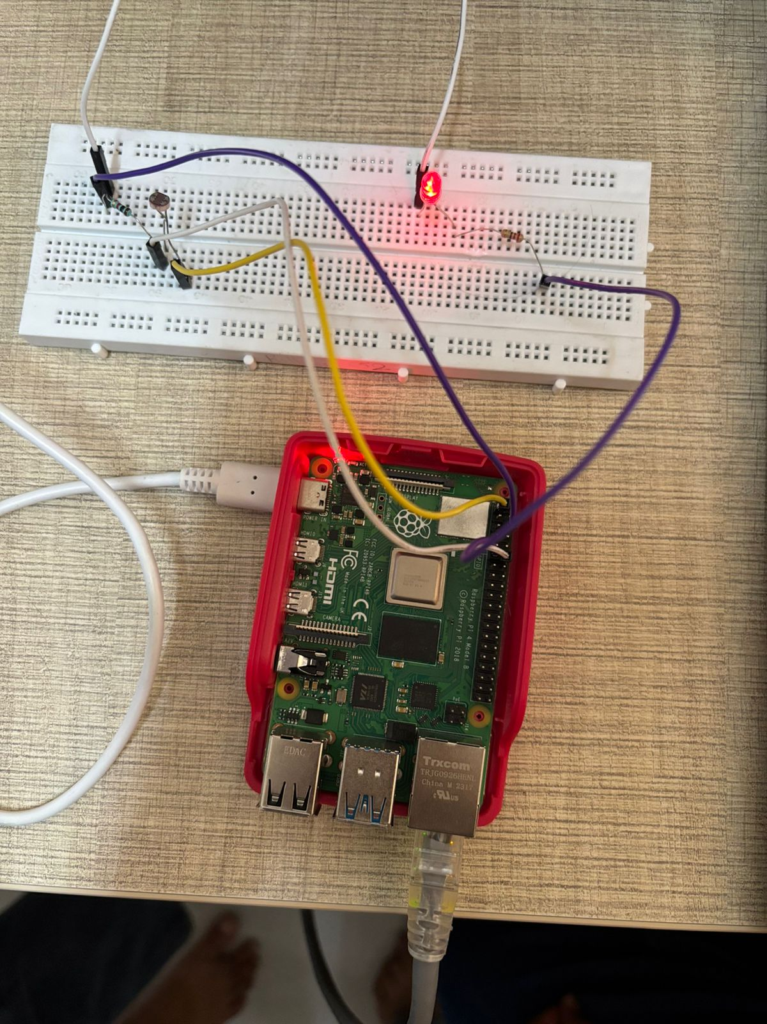
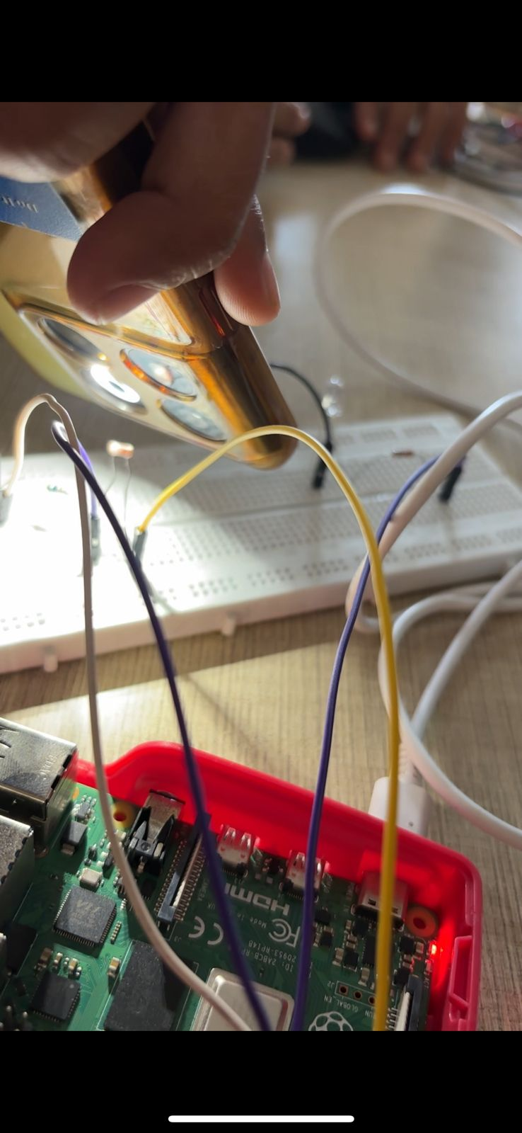
Output:

Slide 9
THANK YOU

